Slide 1
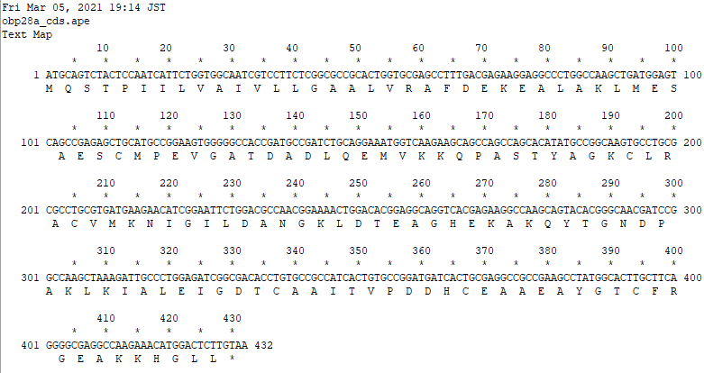
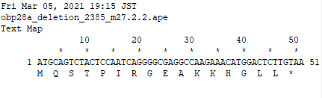
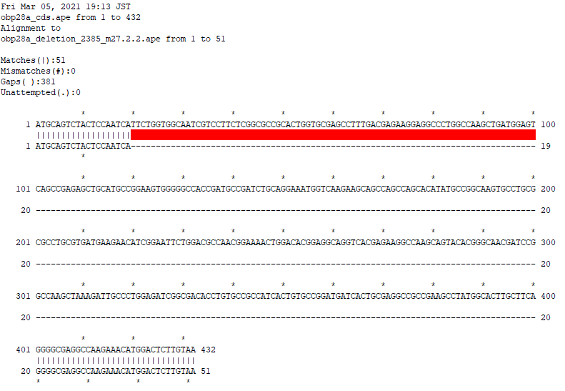
Obp28a mutant- CDS and deletion(#2385 m27.2.2)
Obp28a CDS
MQSTPIILVAIVLLGAALVR
AFDEKEALAKLMESAESCMP
EVGATDADLQEMVKKQPAST
YAGKCLRACVMKNIGILDAN
GKLDTEAGHEKAKQYTGNDP
AKLKIALEIGDTCAAITVPD
DHCEAAEAYGTCFRGEAKKH
GLL*
Obp28a mutant deletion -2385 m27.2.2
MQSTPIRGEAKKHGLL*
2L:complement(7496930..7497310)

Slide 2
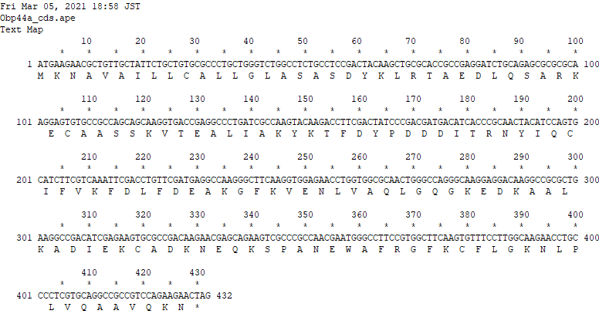
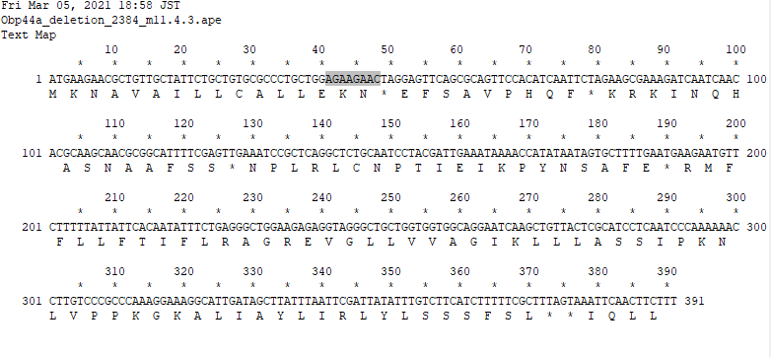
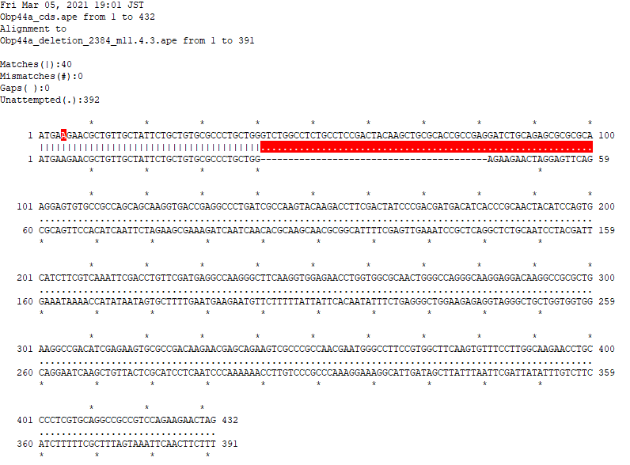
Obp44a mutant- CDS and deletion(#2384 m11.4.3)
Obp44a CDS
MKNAVAILLCALLGLASASD
YKLRTAEDLQSARKECAASS
KVTEALIAKYKTFDYPDDDI
TRNYIQCIFVKFDLFDEAKG
FKVENLVAQLGQGKEDKAAL
KADIEKCADKNEQKSPANEW
AFRGFKCFLGKNLPLVQAAV
QKN*
Obp44a mutant deletion -2384 m11.4.3
???(113 extra codons after stop)
MKNAVAILLCALLEKN*EFS
AVPHQF*KRKINQHASNAAF
SS*NPLRLCNPTIEIKPYNS
AFE*RMFFLLFTIFLRAGRE
VGLLVVAGIKLLLASSIPKN
LVPPKGKALIAYLIRLYLSS
SFSL**IQLL

Slide 3
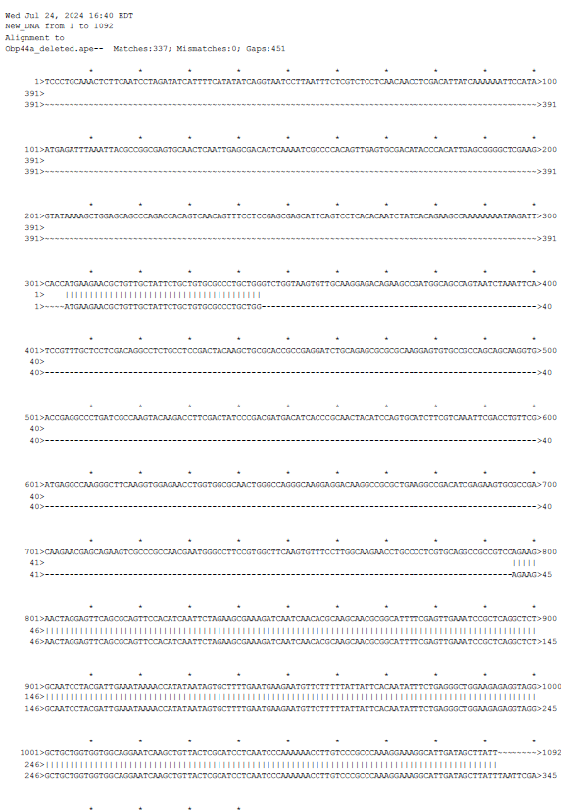
Obp44a mutant- gene region and deletion(#2384 m11.4.3)
2R:complement(8134521..8134971)

Slide 4
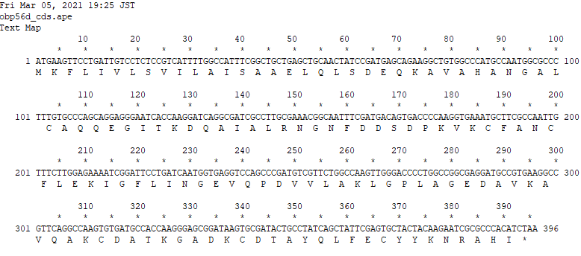
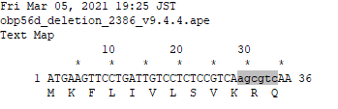
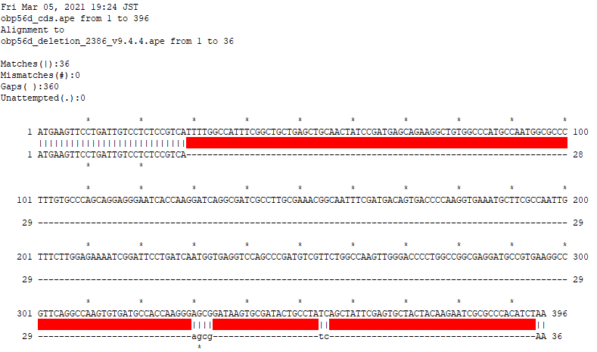
Obp56d mutant- CDS and deletion(#2386 v9.4.4)
Obp56d CDS
MKFLIVLSVILAISAAELQL
SDEQKAVAHANGALCAQQEG
ITKDQAIALRNGNFDDSDPK
VKCFANCFLEKIGFLINGEV
QPDVVLAKLGPLAGEDAVKA
VQAKCDATKGADKCDTAYQL
FECYYKNRAHI*
Obp56d mutant deletion -2386 v9.4.4
???(110 extra codons after stop)
MKFLIVLSVKRQAPNLRYSP
V**SVCDLLLILF*FSISIR
KQNF*ICKCFE**TQEYISF
LKKNLTRNLCETMFQIEDHA
*SFYITLLESHLAFVNILNI
NVKRLIK*LFSCPTKT*RNL
PGK*LT*TPNRE
2R:complement(19703005..19703722)

Slide 5
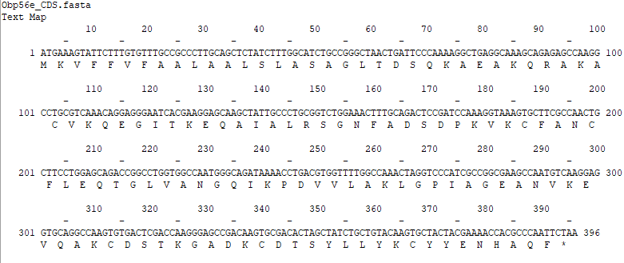
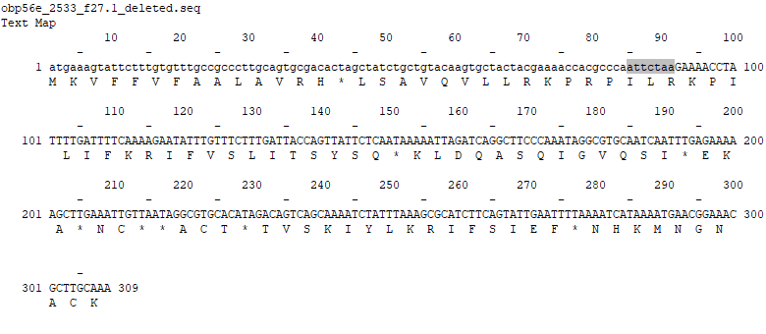
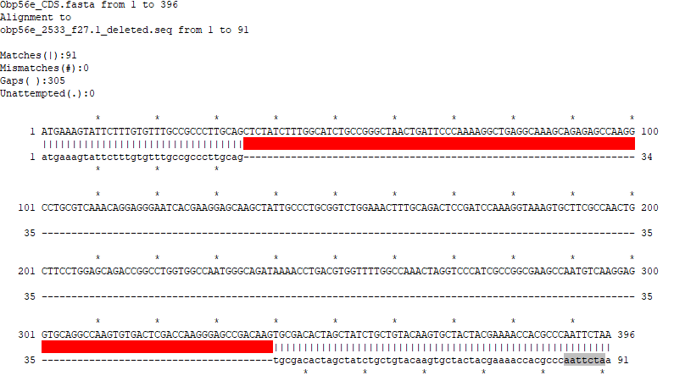
Obp56e mutant- CDS and deletion(#2533 f27.1)
Obp56e CDS
MKVFFVFAALAALSLASAGL
TDSQKAEAKQRAKACVKQEG
ITKEQAIALRSGNFADSDPK
VKCFANCFLEQTGLVANGQI
KPDVVLAKLGPIAGEANVKE
VQAKCDSTKGADKCDTSYLL
YKCYYENHAQF*
Obp56e mutant deletion -2533 f27.1
???(88 extra codons after stop)
MKVFFVFAALAVRH*LSAVQ
VLLRKPRPILRKPILIFKRI
FVSLITSYSQ*KLDQASQIG
VQSI*EKA*NC**ACT*TVS
KIYLKRIFSIEF*NHKMNGN
ACK
2R:19712431..19712794

Slide 6
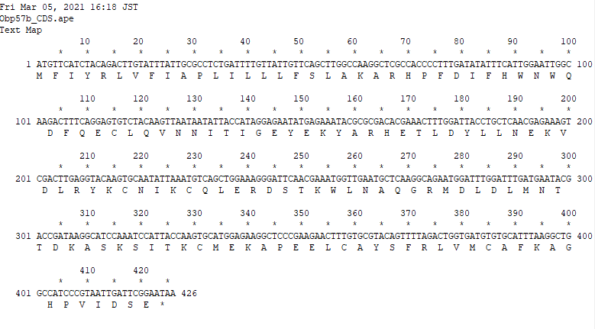
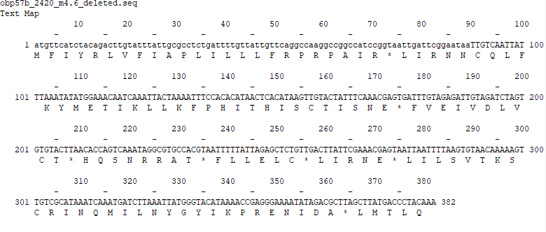
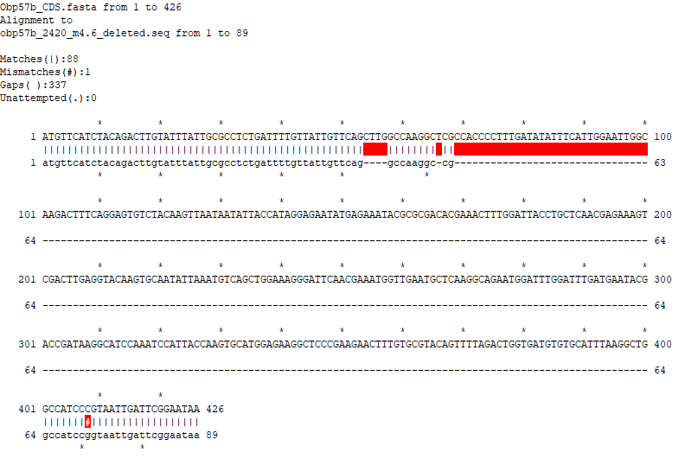
Obp57b mutant- CDS and deletion(#2420 m4.6)
Obp57b CDS
MFIYRLVFIAPLILLLFSLA
KARHPFDIFHWNWQDFQECL
QVNNITIGEYEKYARHETLD
YLLNEKVDLRYKCNIKCQLE
RDSTKWLNAQGRMDLDLMNT
TDKASKSITKCMEKAPEELC
AYSFRLVMCAFKAGHPVIDS
E*
Obp57b mutant deletion -2420 m4.6
???(102 extra codons after stop)
MFIYRLVFIAPLILLLFRPR
PAIR*LIRNNCQLFKYMETI
KLLKFPHITHISCTISNE*F
VEIVDLVCT*HQSNRRAT*F
LLELC*LIRNE*LILSVTKS
CRINQMILNYGYIKPRENID
A*LMTLQ*
2R:20504319..20504728

Slide 7
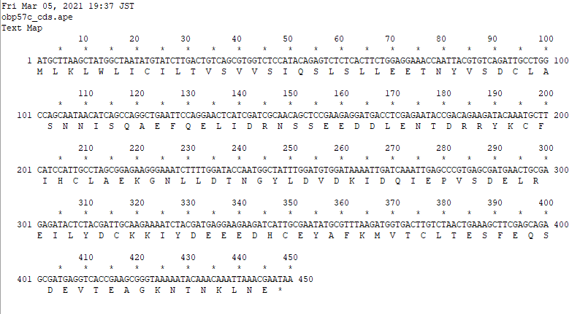
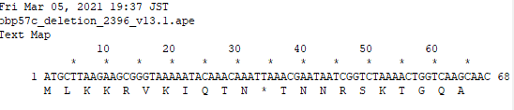
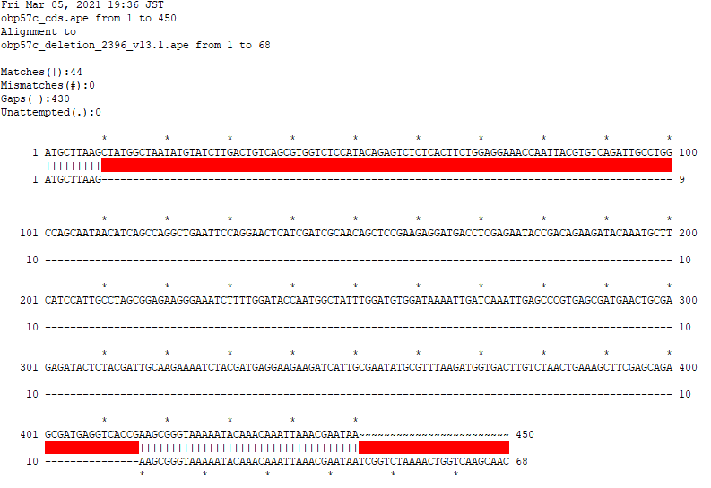
Obp57c mutant- CDS and deletion(#2396 v13.1)
Obp57c CDS
MLKLWLICILTVSVVSIQSL
SLLEETNYVSDCLASNNISQ
AEFQELIDRNSSEEDDLENT
DRRYKCFIHCLAEKGNLLDT
NGYLDVDKIDQIEPVSDELR
EILYDCKKIYDEEEDHCEYA
FKMVTCLTESFEQSDEVTEA
GKNTNKLNE*
Obp57c mutant deletion -2396 v13.1
MLKKRVKIQTN*TNNRSKTG
QA
2R:20503676..20504143

Slide 8
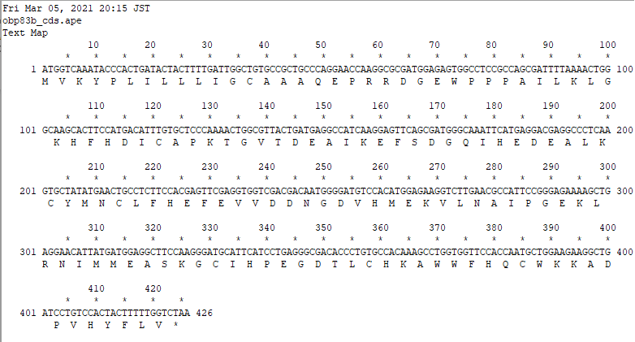
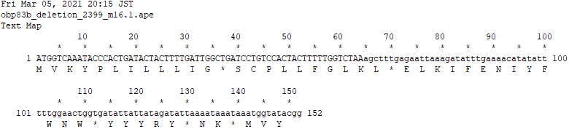
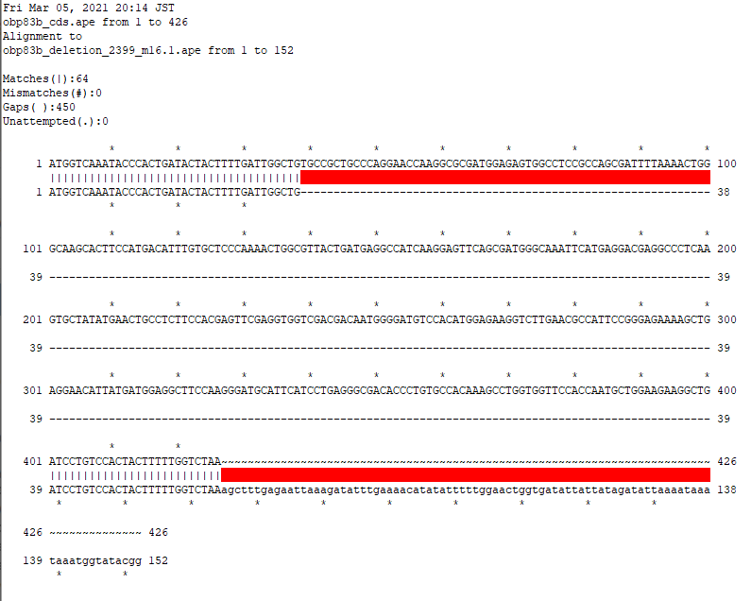
Obp83b mutant- CDS and deletion(#2399 m16.1)
Obp83b CDS
MVKYPLILLLIGCAAAQEPR
RDGEWPPPAILKLGKHFHDI
CAPKTGVTDEAIKEFSDGQI
HEDEALKCYMNCLFHEFEVV
DDNGDVHMEKVLNAIPGEKL
RNIMMEASKGCIHPEGDTLC
HKAWWFHQCWKKADPVHYFL
V*
Obp83b mutant deletion -2399 m25.1
MVKYPLILLLIG*SCPLLFG
LKL*ELKIFENIYFWNW*YY
YRY*NK*MVY
3R:complement(5976291..5976765)

Slide 9
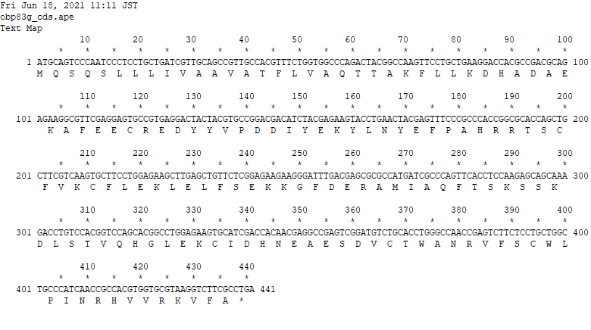
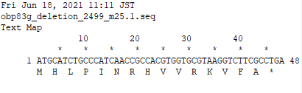
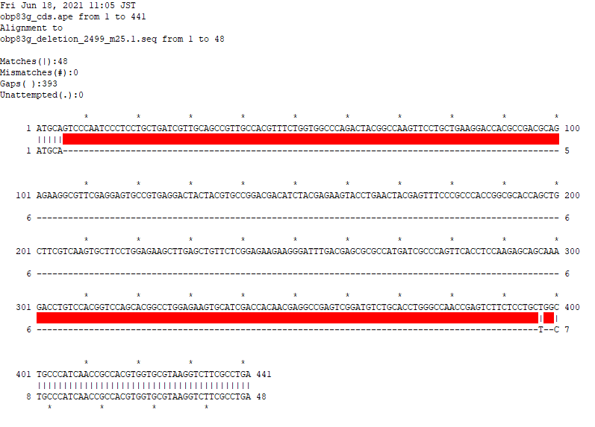
Obp83g mutant- CDS and deletion(#2499 m25.1)
Obp83g CDS
MQSQSLLLIVAAVATFLVAQ
TTAKFLLKDHADAEKAFEEC
REDYYVPDDIYEKYLNYEFP
AHRRTSCFVKCFLEKLELFS
EKKGFDERAMIAQFTSKSSK
DLSTVQHGLEKCIDHNEAES
DVCTWANRVFSCWLPINRHV
VRKVFA*
Obp83g mutant deletion -2499 m25.1
MHLPINRHVVRKVFA*
3R:complement(6111785..6112241)

Slide 10
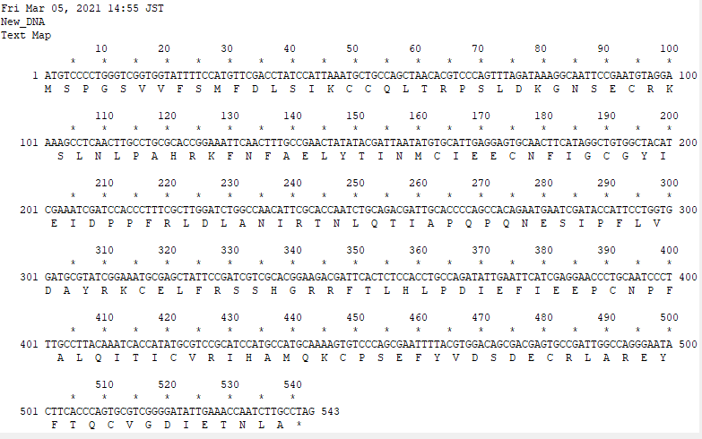
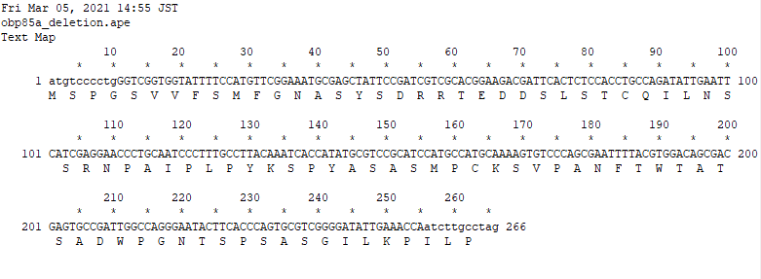
Obp85a mutant- CDS and deletion(#2422 m12.5)
Obp85a CDS
MSPGSVVFSMFDLSIKCCQL
TRPSLDKGNSECRKSLNLPA
HRKFNFAELYTINMCIEECN
FIGCGYIEIDPPFRLDLANI
RTNLQTIAPQPQNESIPFLV
DAYRKCELFRSSHGRRFTLH
LPDIEFIEEPCNPFALQITI
CVRIHAMQKCPSEFYVDSDE
CRLAREYFTQCVGDIETNLA
*
Obp85a mutant deletion -2422 m12.5, m12.8
MSPGSVVFSMFGNASYSDRR
TEDDSLSTCQILNSSRNPAI
PLPYKSPYASASMzPCKSVPA
NFTWTATSADWPGNTSPSAS
GILKPILP
3R:complement(8420054..8420562)

Slide 11
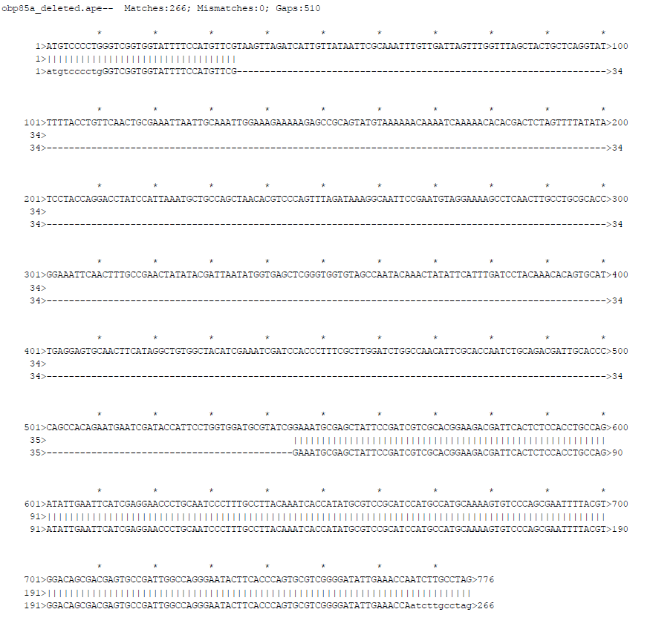
Obp85a mutant- gene region and deletion(#2422 m12.5)

Slide 12
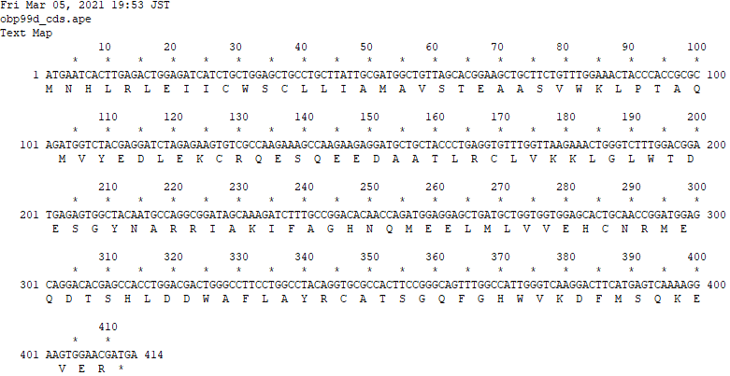
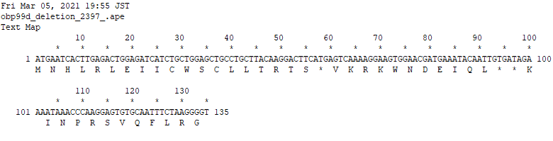
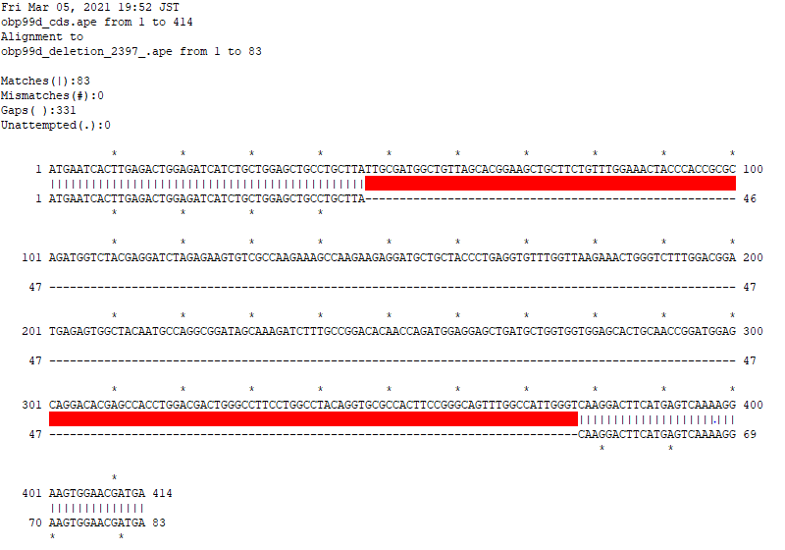
Obp99d mutant- CDS and deletion(#2397 v8.6)
Obp99d CDS
MNHLRLEIICWSCLLIAMAV
STEAASVWKLPTAQMVYEDL
EKCRQESQEEDAATLRCLVK
KLGLWTDESGYNARRIAKIF
AGHNQMEELMLVVEHCNRME
QDTSHLDDWAFLAYRCATSG
QFGHWVKDFMSQKEVER*
Obp99d mutant deletion -2397 v8.6
MNHLRLEIICWSCLLTRTS*
VKRKWNDEIQL**KINPRSV
QFLRG
3R:29714585..29714915

